Slide 1
Open Links
Radzen Blazor Components
MudBlazor
MatBlazor
AntBlazor
Blazorise

Slide 2
Open Links (new window)
My GitHub

Slide 3
Open Projects
BlastOffWithBlazor.Demos
UpBlazor
Start Presentation Mode (View | Appearance)

Slide 4
Pre-setup
Open Rider demos in separate windows/desktops: ‘xyz’, ‘abc’
Open demo key points in a separate window
Call SSW TV in Teams
Powerpoint up
All chat feeds up for live questions/interactions
Open Twitter backchannel on phone
Open in Chrome
AntBlazor/AntDesign + BootstrapBlazor, MudBlazor, MatBlazor etc + AntBlazor GH, My GH, My People Profile

Slide 5

Enterprise Software Development

Slide 6


Slide 7




Luke Parker
SSW Software Architect
Blazor Specialist
Using Blazor since the previews
AntBlazor team member
github.com/Hona
lukeparker.dev

Slide 8


Scan QR Code to install app
Scan SSW codes at talks and events
Earn SSW Points
claim rewards, and win prizes
SSW Rewards

Slide 9
Agenda
Overview of Blazor
Open-Source Component Library Comparisons
Demos
AntBlazor Tips and Tricks
Summary

Slide 10
Agenda
Overview of Blazor
Open-Source Component Library Comparisons
Demos
AntBlazor Tips and Tricks
Summary

Slide 11
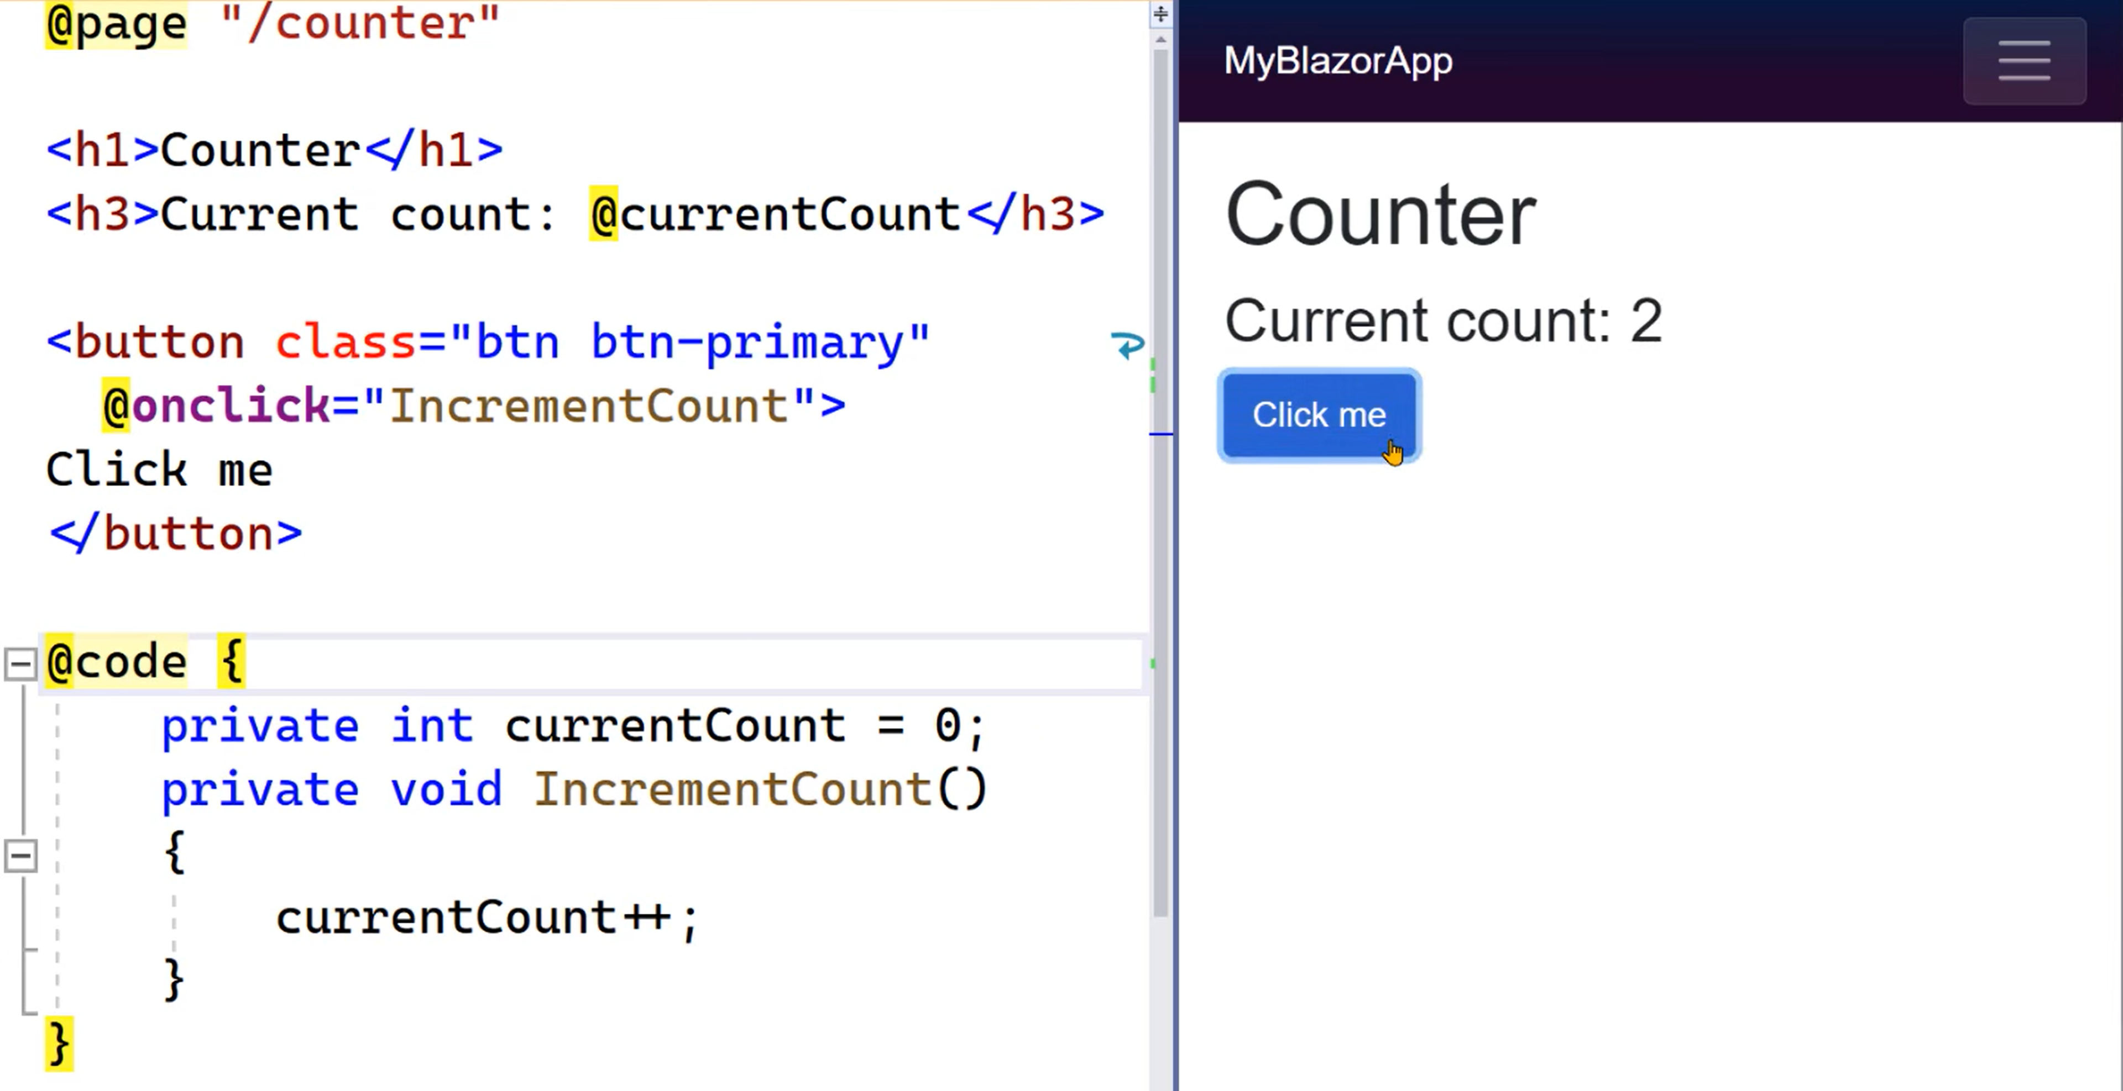
Where Blazor Started

Slide 12
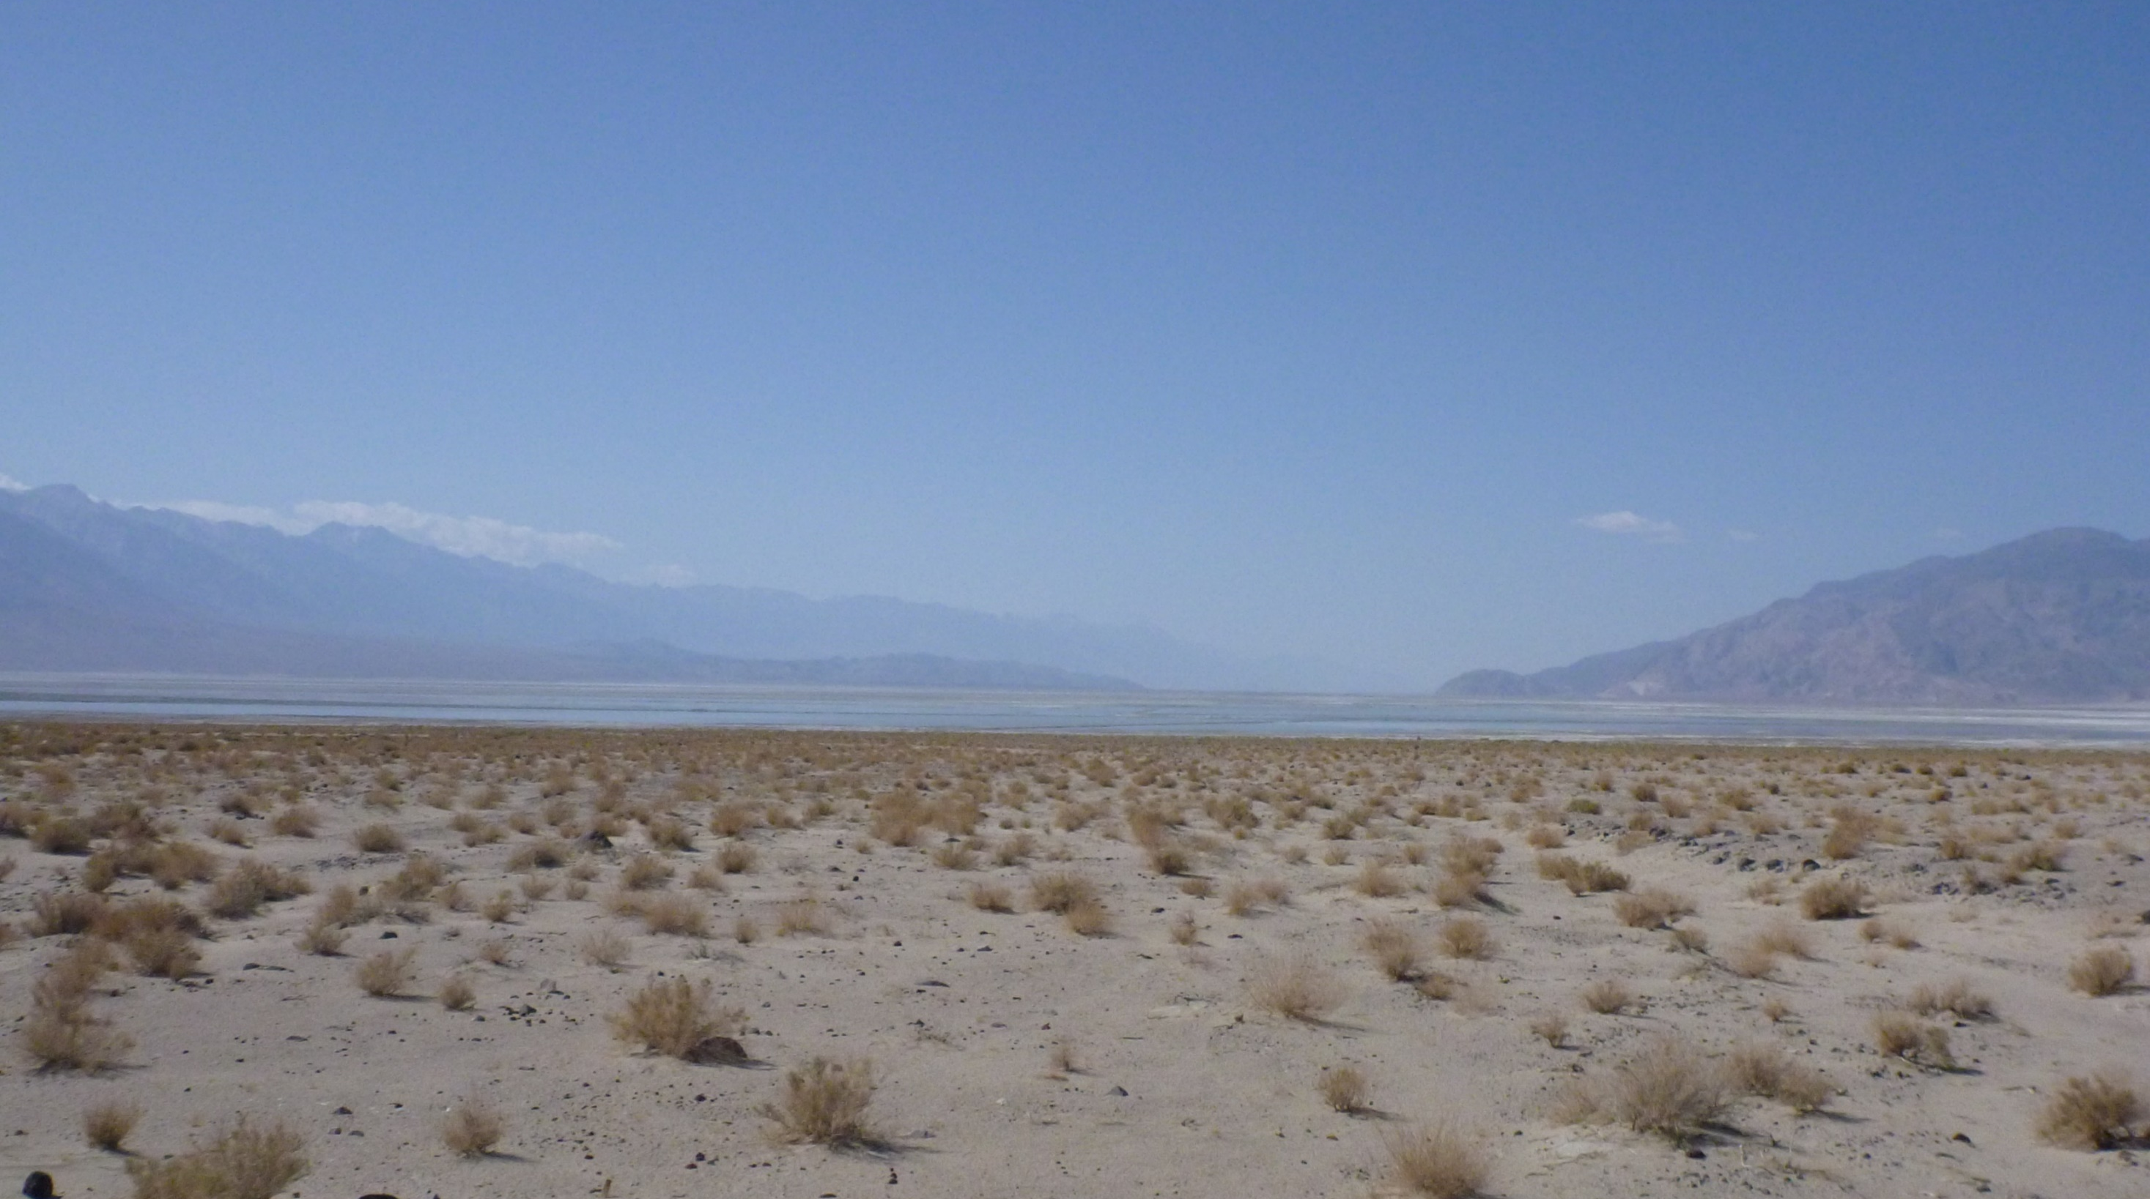

Slide 13







Where are we now?

Slide 14
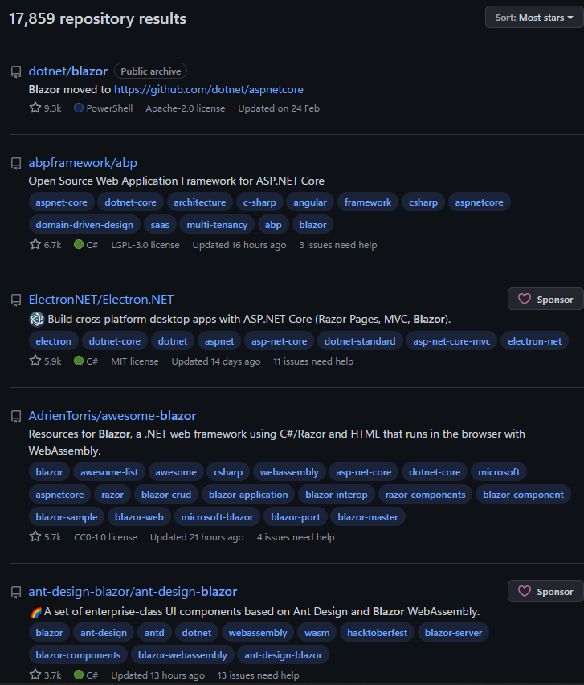

Slide 15
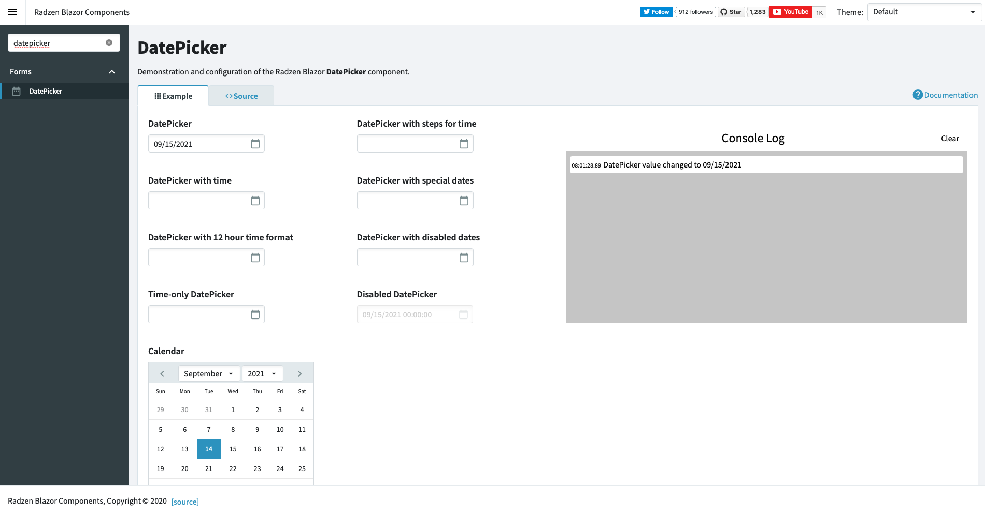
Radzen Blazor - blazor.radzen.com

Slide 16
Radzen Blazor
Not dependent on an existing JS framework
Bad documentation
Not used much – No support in forums
Old design
Bad Performance

Slide 17
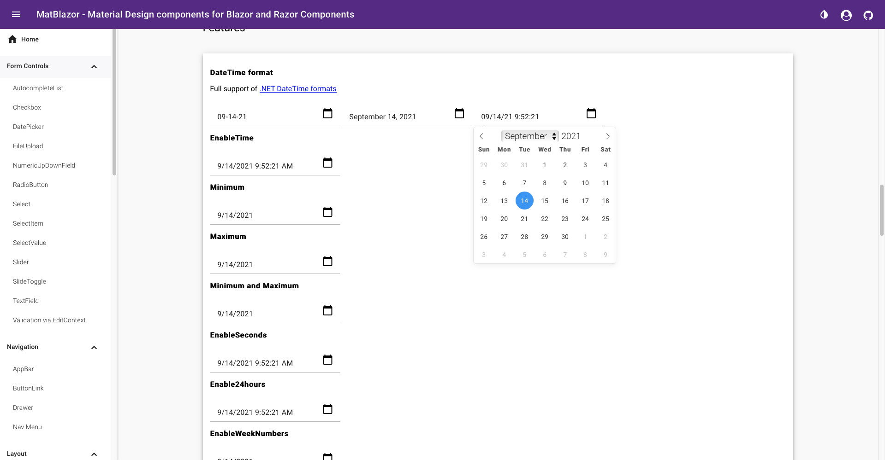
MatBlazor – matblazor.com

Slide 18
MatBlazor
Material Design
Large Package size
Material Design

Slide 19
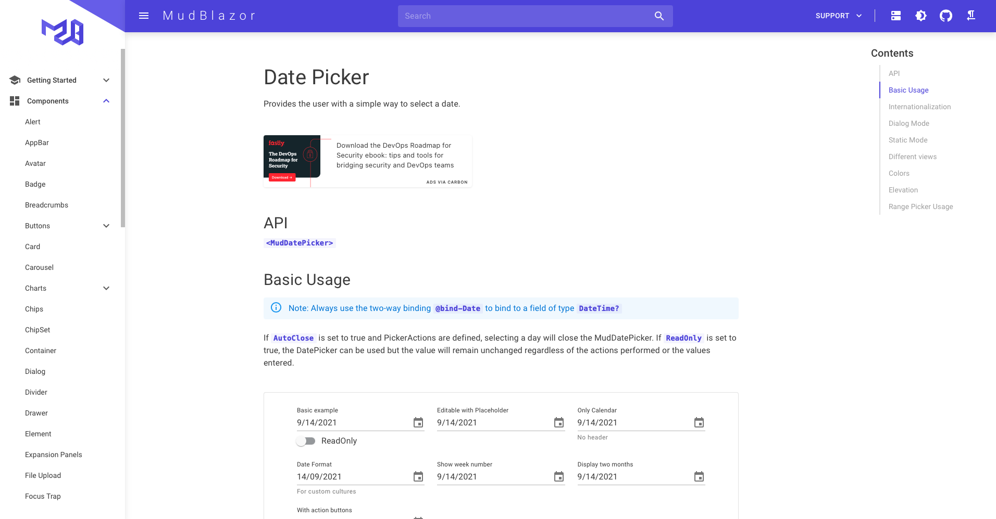
MudBlazor – mudblazor.com

Slide 20
MudBlazor
Modern design
Fast loading
Small package
Good documentation
Annoying to setup

Slide 21
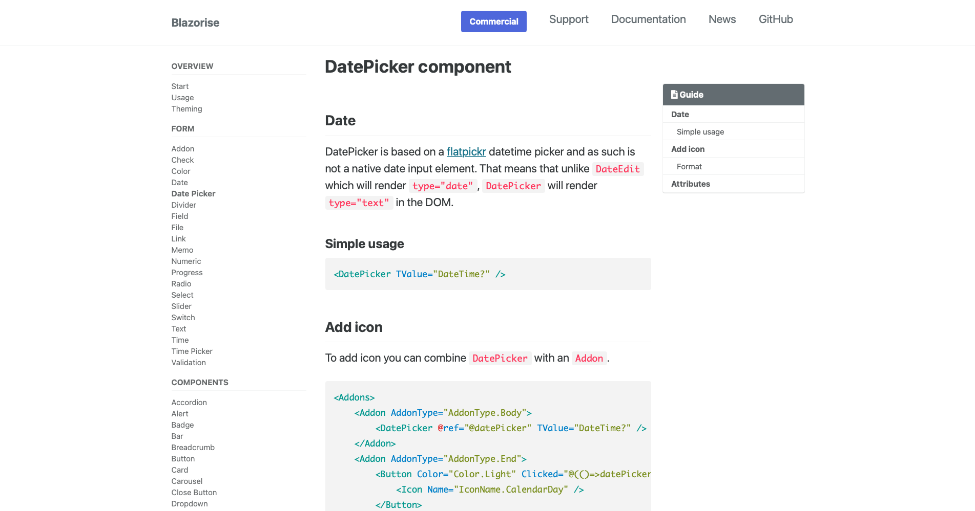
Blazorise – blazorise.com

Slide 22
Blazorise
Not tied to CSS framework
Abstracts UI framework from UI code
Ugly design
Not very popular

Slide 23
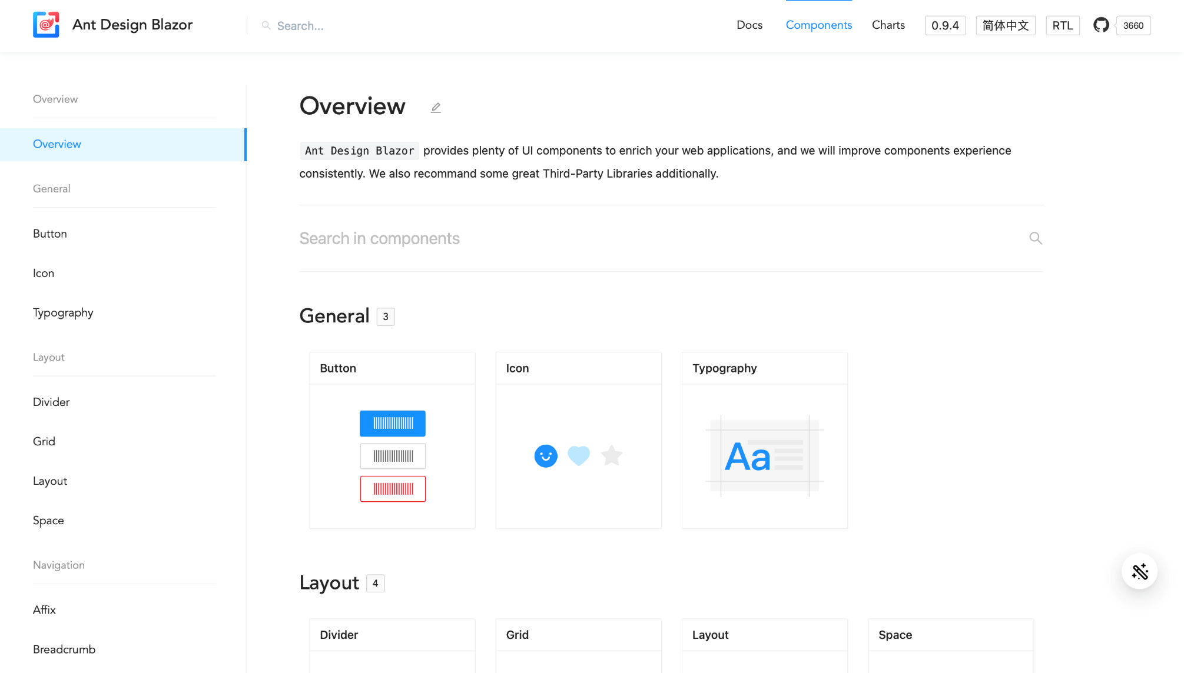
AntBlazor – antblazor.com

Slide 24
AntBlazor
Active open-source community
Beautiful component design
Too good

Slide 25
AntBlazor
Active open-source community
Beautiful component design
Too good

Slide 26
AntBlazor
Active open-source community
Beautiful component design
Too good
No cons

Slide 27
Demos!

Slide 28
Getting setup with AntBlazor Boilerplate
How long does it take before I can really use it?
What is AntBlazor Pro?

Slide 29
Tree View Comparison
How long does it take building it from scratch, versus doing it with AntBlazor?

Slide 30
Template WeatherForecast with AntBlazor

Slide 31
UpBlazor demo
Graphs, tables, forms and more!
https://up.lukeparker.dev
https://github.com/Hona/UpBlazor

Slide 32
Wrap Up

Slide 33
Resources
Demo Code + Copy of Powerpoint https://github.com/Hona/BlastOffWithBlazor.Demos
UpBlazor
https://github.com/Hona/UpBlazor
AntBlazor
https://antblazor.com

Slide 34
Acknowledgements
Andrzej Bakun (@anddrzejb)
Brady Stroud (@bradystroud)

Slide 35




Scan the QR code below and earn
SSW Points for watching this talk!

Slide 36

Got feedback?
Scan the QR code below to fill our survey.
Luke Parker
Blast off with Blazor! 🚀 - Supercharged Enterprise UIs using AntDesign

Slide 37
Thank you
www.ssw.com.au

Slide 38
Questions?

Slide 39
Questions?

Slide 40
Questions?

Slide 41
Questions?

Slide 42
Questions?

